Slide 1
Chongqing University of Technology
ATAI
Advanced Technique of Artificial Intelligence
Chongqing University of Technology
Open Hierarchical Relation Extraction（ACL_2021）
Kai Zhang1∗, Yuan Yao1∗, Ruobing Xie2,Xu Han1, Zhiyuan Liu1†, Fen Lin2, Leyu Lin2
, Maosong Sun1 1Department of Computer Science and Technology
Institute for Artificial Intelligence, Tsinghua University, Beijing, China
Beijing National Research Center for Information Science and Technology, China
2WeChat Search Application Department, Tencent, China
drogozhang@gmail.com, yaoyuanthu@163.com
2021.7.27 • ChongQing
Reported by Le le Duan
Code & dataset:https://github.com/thunlp/OHRE

Slide 2
Chongqing University of Technology
ATAI
Advanced Technique of Artificial Intelligence
Chongqing University of Technology
1.Background
2.Method
3.Experiments

Slide 3
Background
北京是中国的首都：(中国，首都，北京)
限定域关系抽取：在一个或多个限定的领域内判别文本中所出现的实体指称之间是何种语义关系，且待判别的语义关系是预定义的
开放域关系抽取:不需要预先定义关系，而是使用实体对上下文中的一些词语来描述实体之间的关系。

Slide 4
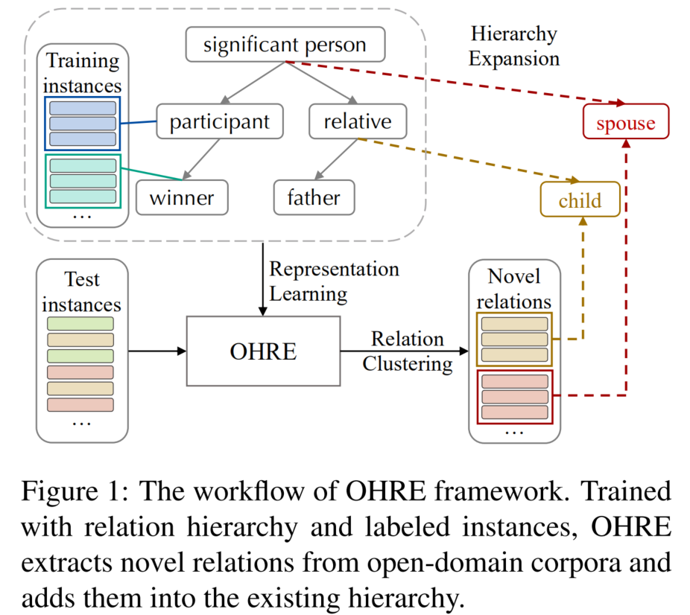
Method
Most OpenRE methods cast different relation types in isolation without considering their hierarchical dependency.

Slide 5
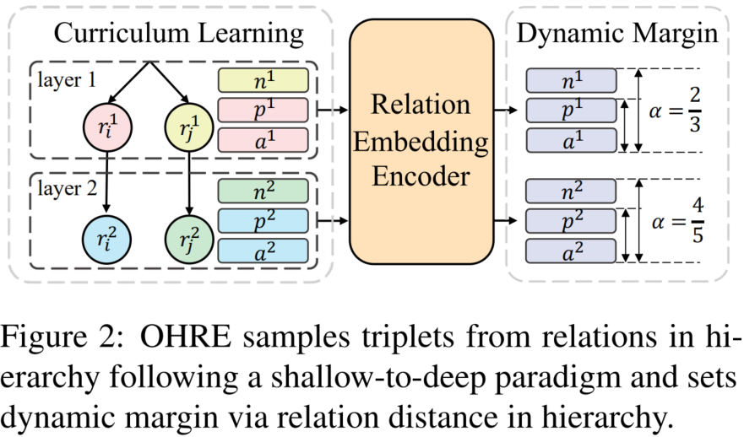
Method
Relation Representation Learning.
Relation Embedding Encoder：
Dynamic Hierarchical Triplet Loss：

Slide 6
Method
Relation Representation Learning.
Pair-wise Virtual Adversarial Training：

Slide 7
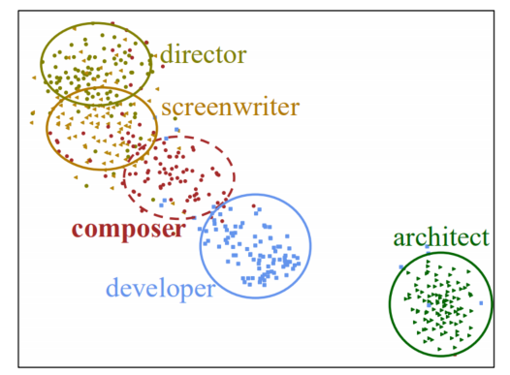
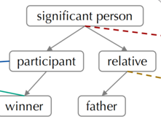
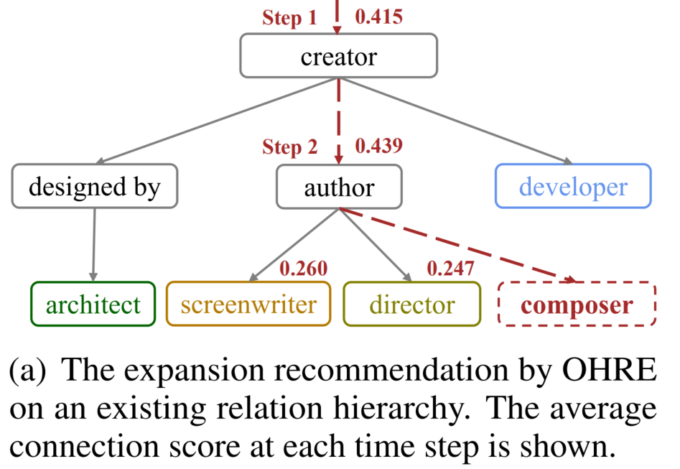
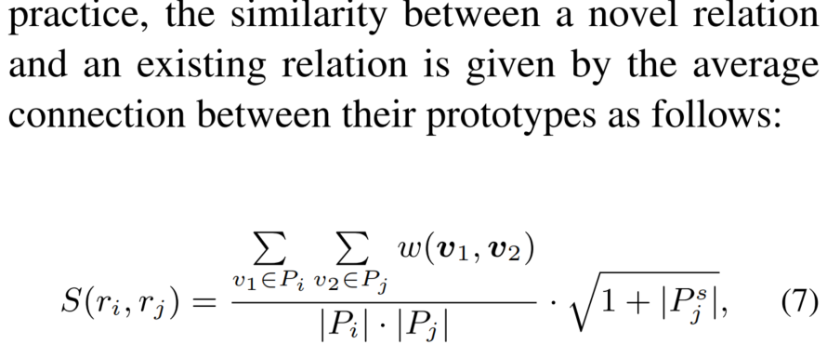
Method
Relation Hierarchy Expansion
Relation Prototype Learning
Clustering novel relations(Louvain algorithm (Blondel et al., 2008).)
in open-domain corpora based on instance representations：
novel relations
existing hierarchy
Learn relation prototypes for both relations in the existing hierarchy and novel relations
Top-Down Hierarchy Expansion

Slide 8
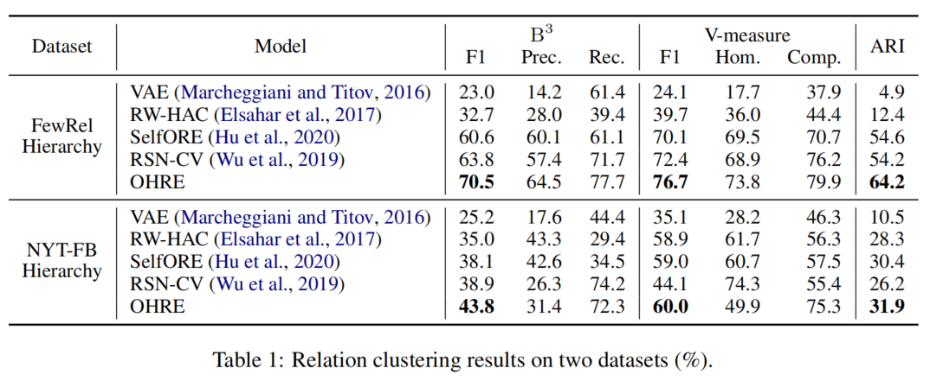
Experiment
Relation Clustering Setting:

Slide 9
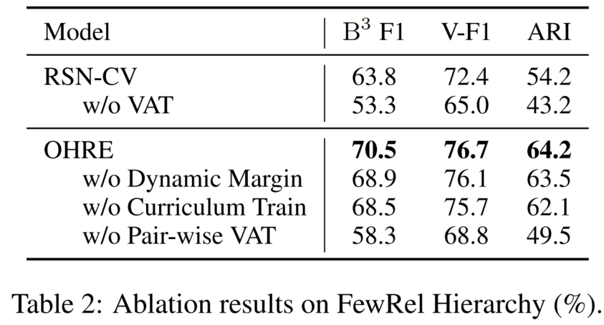
Experiment
Relation Clustering Setting:

Slide 10
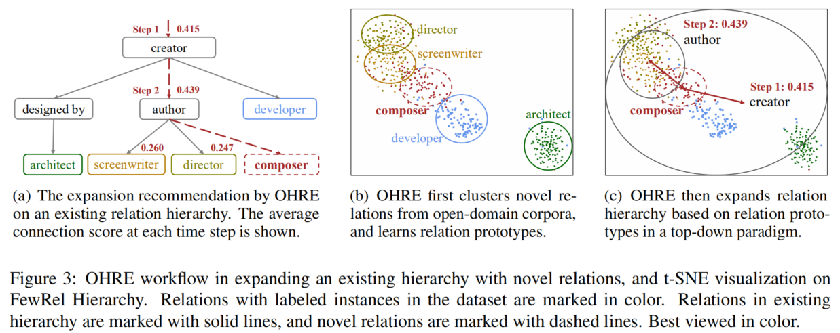
Experiment
Hierarchy Expansion Results:

Slide 11
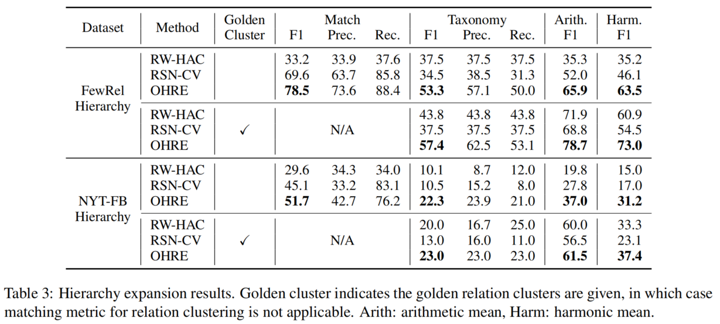
Experiment
Hierarchy Expansion Results:

Slide 12
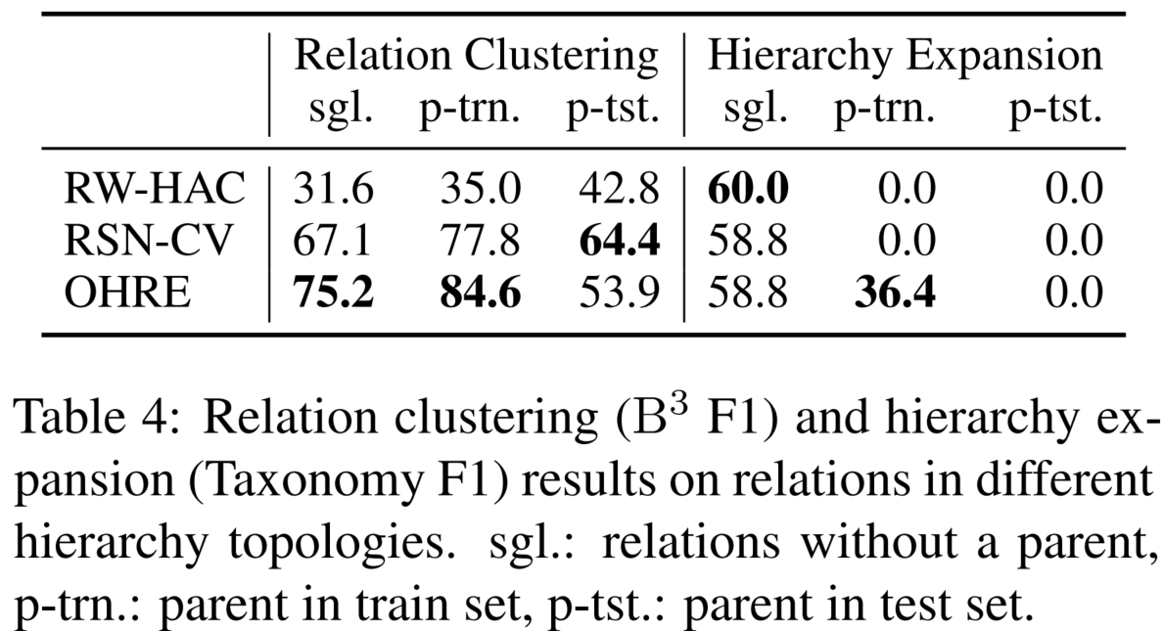
Experiment

Slide 13
Chongqing University of Technology
ATAI
Advanced Technique of Artificial Intelligence
Chongqing University of Technology
Thank you!

